Slide 1

Sean Achtatou
Siwen GUO
University Of Luxembourg
Machine Learning
for Sentiment Analysis
All Right Reserved ©
Summer 2018-2019

Slide 2

1. What is Machine Learning ?

Slide 3


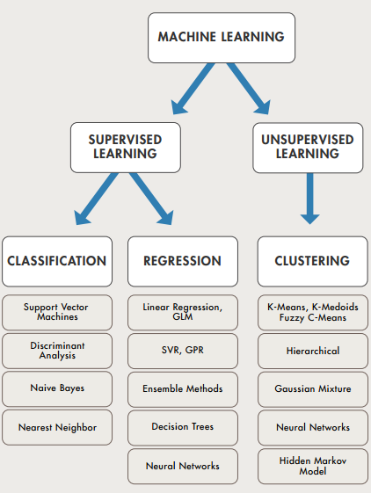
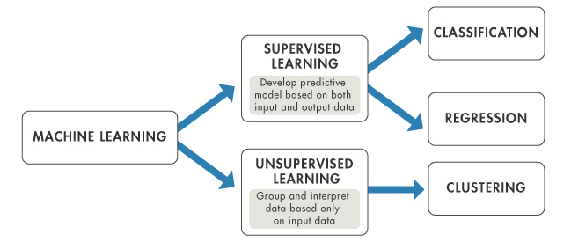
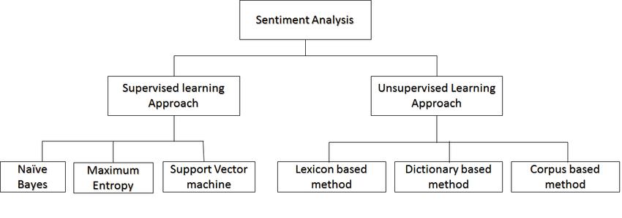
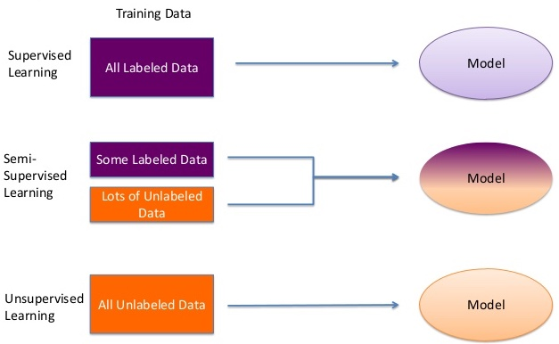
Machine Learning
1. Artifical Intelligence [IA] :
- Machine Learning
- Deep Learning
2. Different types of Machine Learning :
- Supervised
- Unsupervised
- Semi-supervised
3. The Machine Learning is :
- Used in multiples Companies in the worldwide
- Used for Classification, Regression and clustering
- Based on known and unknown data to create a model
- Giving simple results
4. The Machine Learning provides different technique to classify information.
Support Vector Machine [SVM]

Slide 4
2. How does the Support Vector Machine work
in Machine Learning ?

Slide 5
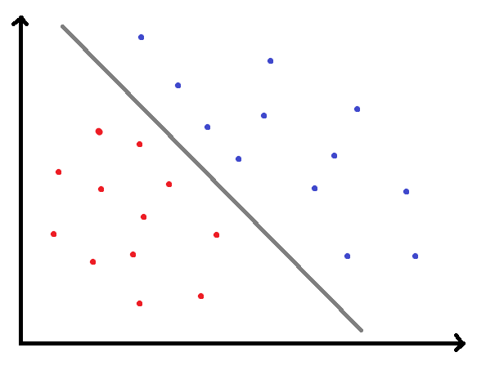
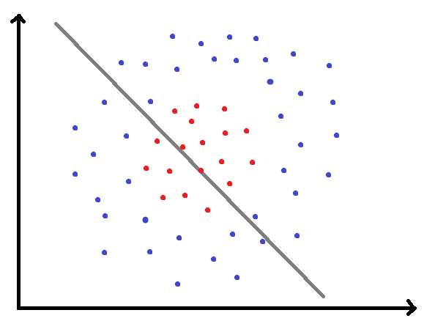
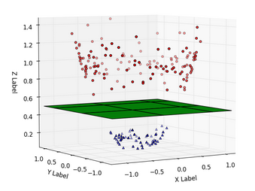
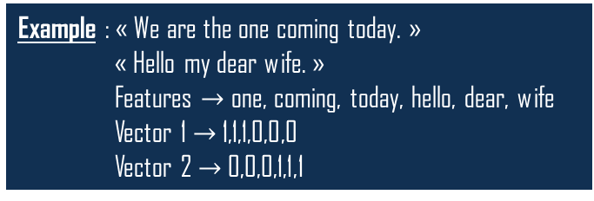
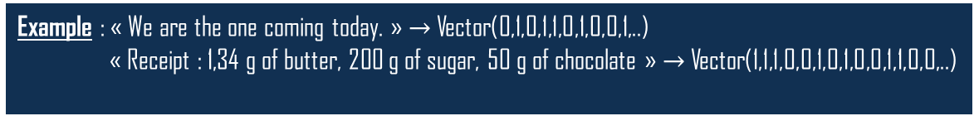
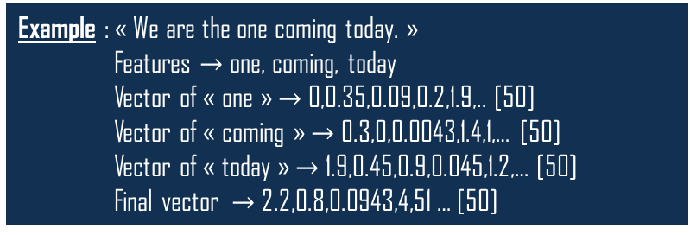
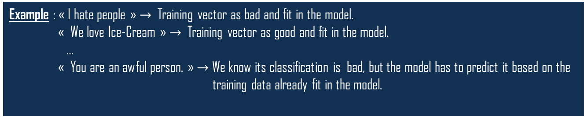
Support Vector Machine [SVM]
1. The Support Vector Machine principles :
- Is based on the creation of model with vectors(data transformed by pre-processing)
- Use training data and test data [pre-processed] as vectors
Example : « We are the one coming today. » $→$ Vector(0,1,0,1,1,0,1,0,0,1,..)
« Receipt : 1,34 g of butter, 200 g of sugar, 50 g of chocolate » $→$ Vector(1,1,1,0,0,1,0,1,0,0,1,1,0,0,..)
- Fit training data set in a model
- Predict the classification of a new data based on the model
Example : « I hate people » $→$ Training vector as bad and fit in the model.
« We love Ice-Cream » $→$ Training vector as good and fit in the model.
…
« You are an awful person. » $→$ We know its classification is bad, but the model has to predict it based on the
training data already fit in the model.
2. Type of use of the Support Vector Machine :
- Linear
- Kernel trick
Example : « Receipt : 1,34 g of butter, 200 g of sugar, 50 g of chocolate »
Normalization : 0.00134 ,0.2 ,0.050
3. The pre-processing :
Example : « We are the one coming today. »
« Hello my dear wife. »
Features $→$ one, coming, today, hello, dear, wife
Vector 1 $→$ 1,1,1,0,0,0
Vector 2 $→$ 0,0,0,1,1,1
- Normalize the data
Example : « We are the one coming today. »
Features $→$ one, coming, today
Vector of « one » $→$ 0,0.35,0.09,0.2,1.9,.. [50]
Vector of « coming » $→$ 0.3,0,0.0043,1.4,1,… [50]
Vector of « today » $→$ 1.9,0.45,0.9,0.045,1.2,… [50]
Final vector $→$ 2.2,0.8,0.0943,4,51 … [50]
- Create the features
- Create the vectors based on the features
- Library « GlOve »

Slide 6

3. Creation of a Machine Learning with the
Support Vector Machine

Slide 7

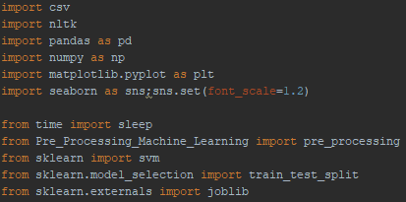
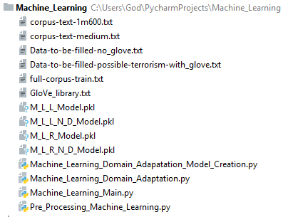
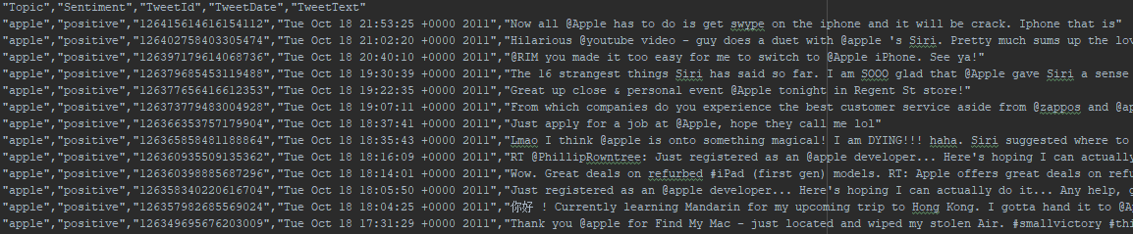
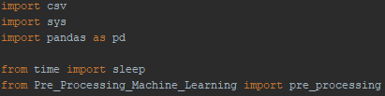
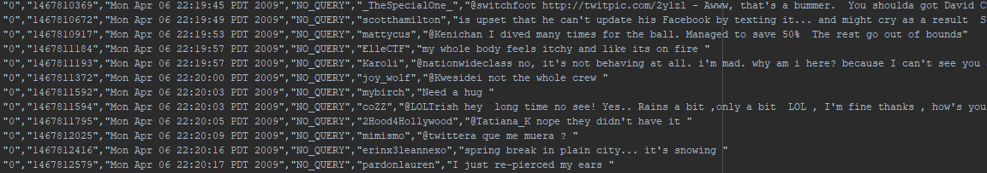
Preparation of the libraries and files for the Machine Learning [with/without glOve]
1. Libraries
2. Importation of the data
3. Structure of the project

Slide 8
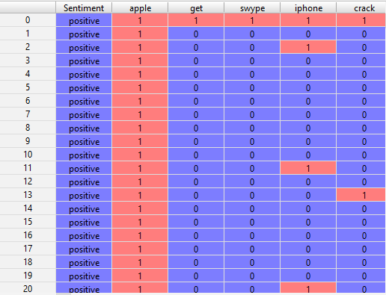
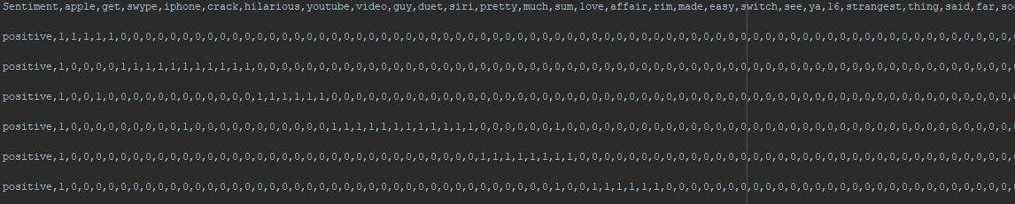
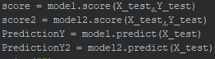
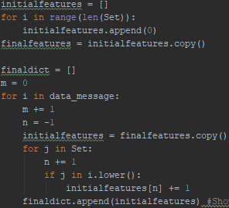
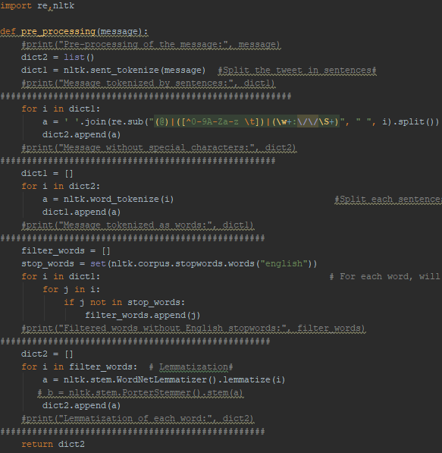
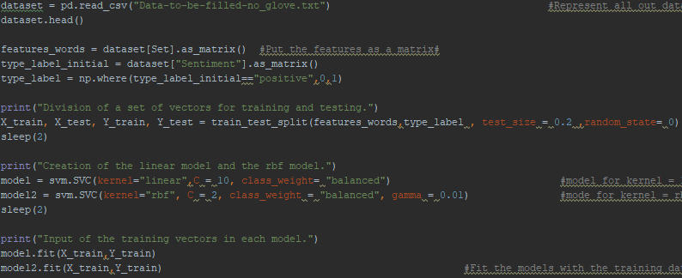
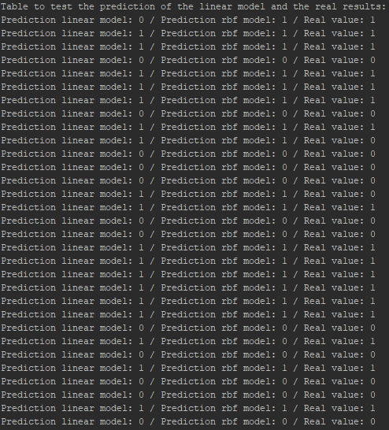
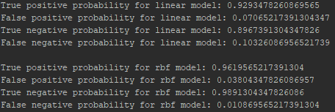
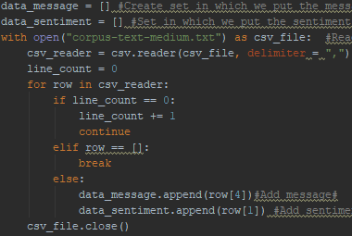
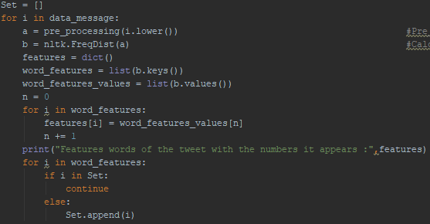
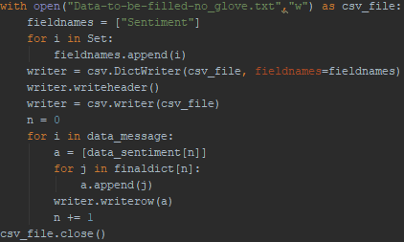
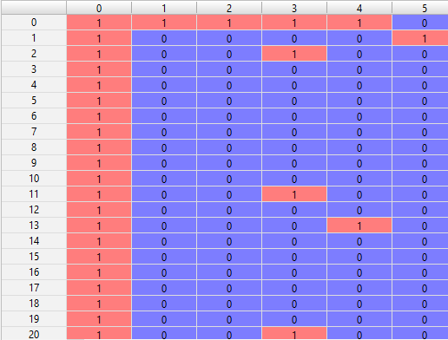
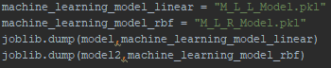
3. Accuracy and table of prediction of the models
2. Creation of linear and kernel models
Machine Learning [without glOve]
1. Pre-processing

Slide 9
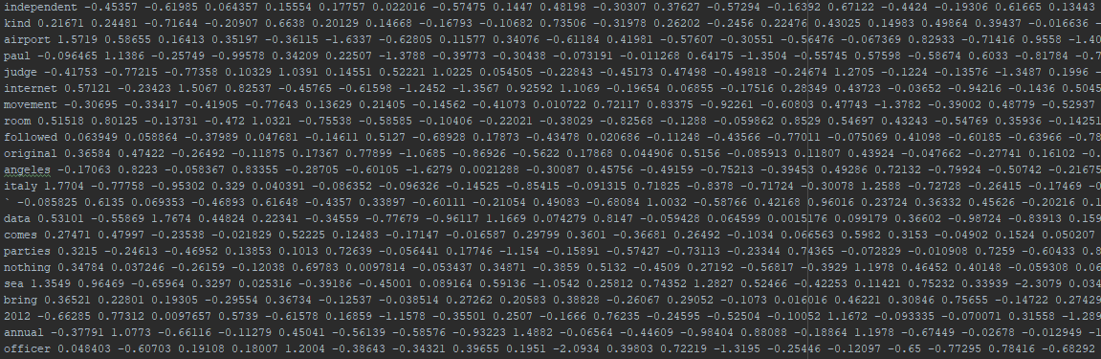
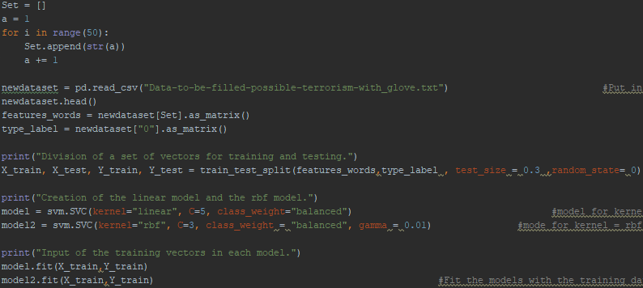
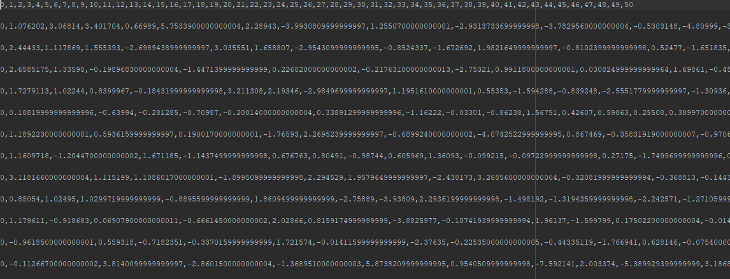
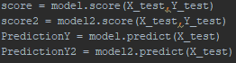
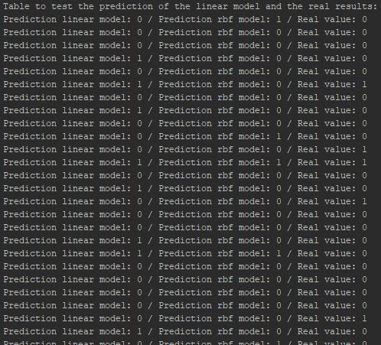
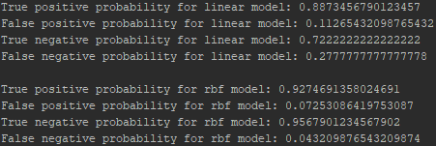
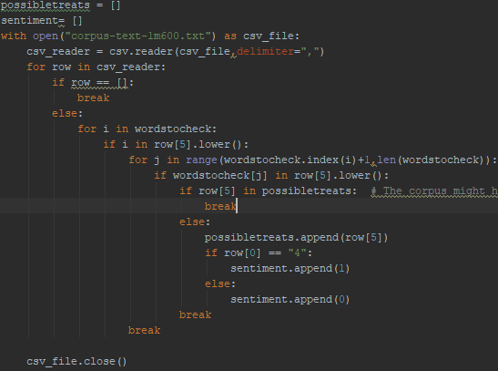
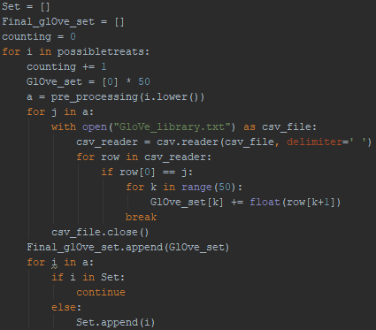
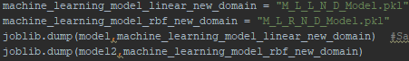
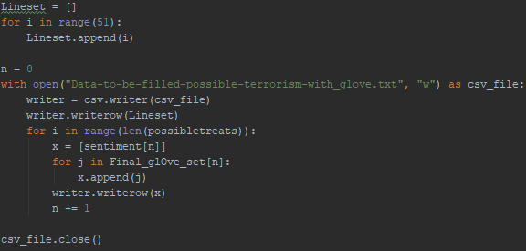
Machine Learning [with glOve]
1. Pre-processing using Glove
2. Creation of linear and kernel models
3. Accuracy and table of prediction of the models

Slide 10

Results
Machine Learning without glOve
Machine Learning with glOve
Linear
Kernel Trick
Linear
Kernel Trick
Accuracy of prediction : 82 %
Accuracy of prediction : 86 %
Accuracy of prediction : 60 %
Accuracy of prediction : 64 %
Prediction/ Sentiment | Positive | Negative
Correct | 0.92 | 0.89
Incorrect | 0.08 | 0.11
Prediction/ Sentiment | Positive | Negative
Correct | 0.96 | 0.98
Incorrect | 0.04 | 0.02
Prediction/ Sentiment | Positive | Negative
Correct | 0.88 | 0.72
Incorrect | 0.12 | 0.28
Prediction/ Sentiment | Positive | Negative
Correct | 0.92 | 0.95
Incorrect | 0.08 | 0.05

Slide 11

Conclusion

